Slide 1
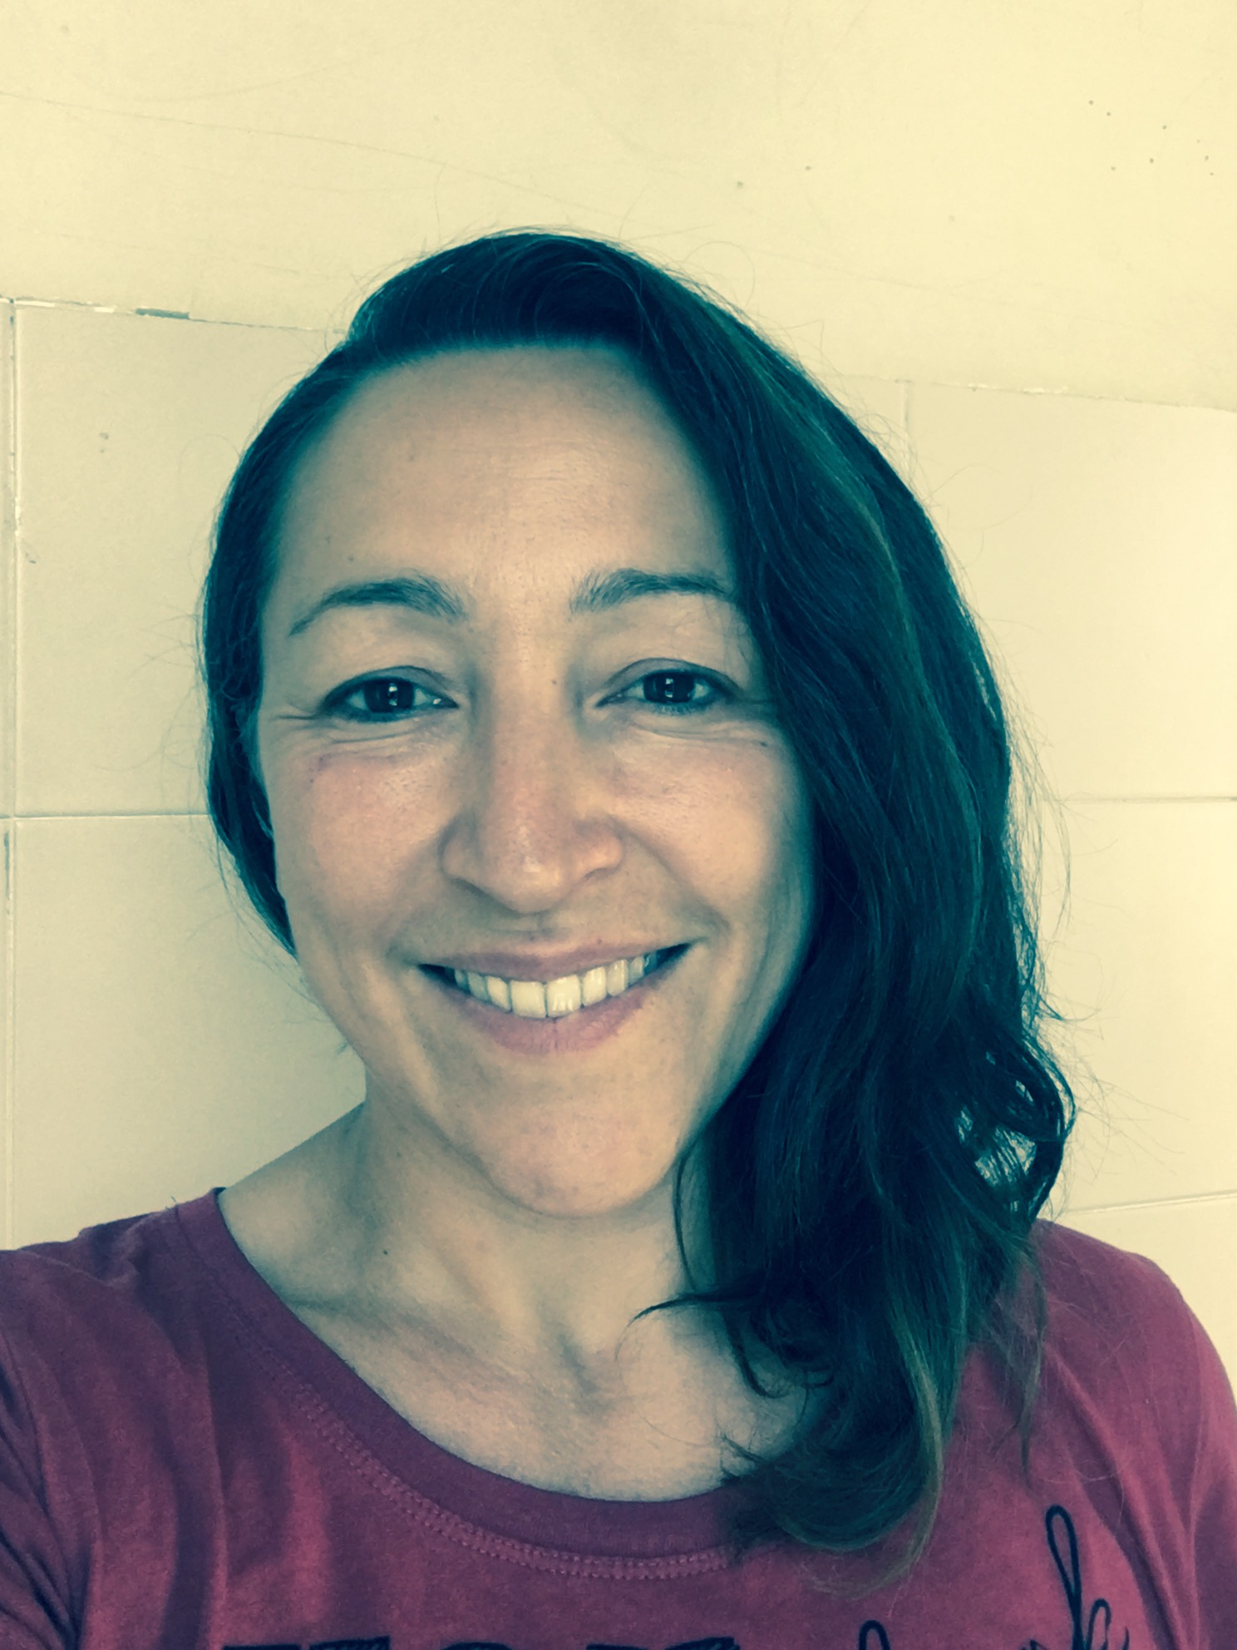

Past simple + BEFORE THE EXAM REVision
Caterina Ines Latella

Slide 2
GRAMMAr CONTENTS of the exam (modules 1,2, 3, 4 - everyday english 2)
Possessive adjectives and pronouns
likes and dislikes
present simple
present continuous – stative verbs
there is –there are (there was/were)
a/an/some/any
past simple

Slide 3
A/AN – SOME/ANY – HAVE/HAS + POSSESSIVE ADJECTIVES
https://cdn.burlingtonenglish.com/cache/worksheets/13/136445_4911c8b123b744201342f82e8e316ba5.pdf
+ solutions: chrome-extension://efaidnbmnnnibpcajpcglclefindmkaj/https://cdn.burlingtonenglish.com/cache/teachermaterials/lessons/15/153272_505e522489022a14376ae1bced1c1f93.pdf
https://elt.oup.com/student/englishfile/elementary3/grammar/file02/?cc=ro&selLanguage=en
https://elt.oup.com/student/englishfile/elementary3/grammar/file01/?cc=ro&selLanguage=en

Slide 4
Like / Love + Noun; Like / Love + Verb+ing
https://cdn.burlingtonenglish.com/cache/worksheets/13/136444_07871beb01fa2c79a02e9fb9feab8255.pdf + solutions: chrome-extension://efaidnbmnnnibpcajpcglclefindmkaj/https://cdn.burlingtonenglish.com/cache/teachermaterials/lessons/15/152421_fe7295e3d77bc1e3416a3d2332628e9b.pdf
https://elt.oup.com/student/englishfile/elementary3/grammar/file06/?cc=ro&selLanguage=en

Slide 5
There is – there are + REVIEW TEST LESSON 1
https://cdn.burlingtonenglish.com/cache/worksheets/13/137774_f6b257057f04b240c876c5e4e466ad33.pdf + solutions: chrome-extension://efaidnbmnnnibpcajpcglclefindmkaj/https://cdn.burlingtonenglish.com/cache/teachermaterials/lessons/15/153037_14a70361f0c1a62ff05ae8c8e8011a4e.pdf
https://cdn.burlingtonenglish.com/cache/worksheets/13/136282_85efe414ad63b1c549b5d178ae00d32e.pdf
+ solutions: chrome-extension://efaidnbmnnnibpcajpcglclefindmkaj/https://cdn.burlingtonenglish.com/cache/teachermaterials/lessons/15/152549_f7ab624ad89406e25d90497b81e41ffc.pdf

Slide 6
PRESENT SIMPLE – PRESENT CONT. + STATE VERBS
https://cdn.burlingtonenglish.com/cache/worksheets/13/136519_1e5684040c749b030b4d4e07762688b5.pdf + solutions: chrome-extension://efaidnbmnnnibpcajpcglclefindmkaj/https://cdn.burlingtonenglish.com/cache/teachermaterials/lessons/15/152695_b25a335f3b2a7fd9757141beaab7c0b4.pdf
https://cdn.burlingtonenglish.com/cache/worksheets/13/136833_b3d3c06297e5bc57823d878cf22c4105.pdf + solutions: chrome-extension://efaidnbmnnnibpcajpcglclefindmkaj/https://cdn.burlingtonenglish.com/cache/teachermaterials/lessons/15/152998_0e88de236e1110f005195334bd231e65.pdf
https://cdn.burlingtonenglish.com/cache/worksheets/13/139072_191e22caa36f5a1ed32b6b6fb1bf3b52.pdf + solutions: chrome-extension://efaidnbmnnnibpcajpcglclefindmkaj/https://cdn.burlingtonenglish.com/cache/teachermaterials/lessons/15/153047_d7c4f7372c49430dea10d3fea0a2cf1d.pdf
https://elt.oup.com/student/englishfile/preint3/grammar/file01/?cc=ro&selLanguage=en
https://elt.oup.com/student/englishfile/elementary3/grammar/file03/?cc=ro&selLanguage=en
https://elt.oup.com/student/englishfile/elementary3/grammar/file04/?cc=ro&selLanguage=en
https://elt.oup.com/student/englishfile/elementary3/grammar/file05/?cc=ro&selLanguage=en

Slide 7
PAST SIMPLE
https://cdn.burlingtonenglish.com/cache/worksheets/13/136631_2fb2c42e06af63ccb94f988e53eb8328.pdf + solutions: chrome-extension://efaidnbmnnnibpcajpcglclefindmkaj/https://cdn.burlingtonenglish.com/cache/teachermaterials/lessons/16/165344_fa83ca44edf217afde4937b2573f6c57.pdf
https://elt.oup.com/student/englishfile/preint3/grammar/file02/?cc=ro&selLanguage=en
https://elt.oup.com/student/englishfile/elementary3/grammar/file07/?cc=ro&selLanguage=en
https://elt.oup.com/student/englishfile/elementary3/grammar/file08/?cc=ro&selLanguage=en

Slide 8
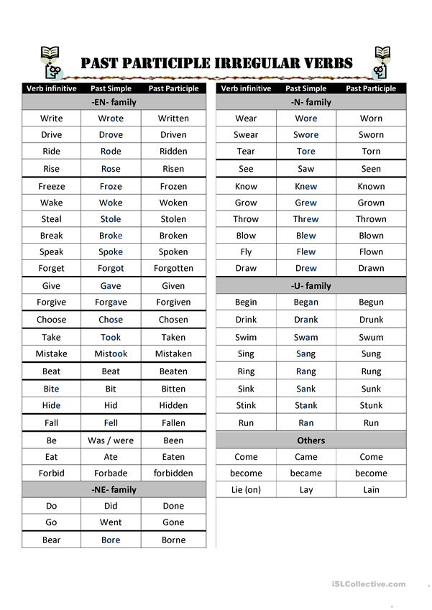
irREGULAR VERBS

Slide 9
SOME PRACTICE – PAST SIMPLE :
Task. 1 Ask a question to get the following information about a past action.
- something you bought yesterday - What did you buy yesterday?
- the last thing you lost - What was the last thing…?
- what you did yesterday evening - What did you do yesterday?
- the last time you did some exercise - When was the last…?
- the last time you went out with your friends – When was….?
- how much money you spent yesterday - How much money did you spend…?

Slide 10
SOME PRACTICE – PAST SIMPLE :
Task. 2 Ask and answer the following questions
When did you last go a restaurant?’ / ‘When did you last go to the cinema?’.
Ask students what other questions you could ask about this event eg. for the restaurant they might say:
Which restaurant did you go to?
Who did you go with?
What did you eat?
Did you like it?
Did you have dessert?
What did you talk about?

Slide 11
SOME PRACTICE – PAST SIMPLE :
Task. 3 Tell a story by answering the following questions:
What? - What not?
When? - When not?
Why? - Why not?
Who with? - Who with not?
How?
Etc….

Slide 12
Keep practicing
https://elt.oup.com/student/englishfile/preint3/grammar/file02/grammar02_a01?cc=it&selLanguage=it
https://elt.oup.com/student/englishfile/preint3/grammar/file02/grammar02_a02?cc=it&selLanguage=it
https://learnenglish.britishcouncil.org/english-grammar-reference/past-simple

Slide 13

THANK YOU FOR YOUR attention

